Slide 1


UiPath Nanyang Polytechnic School of Information Technology

Slide 2

Introduction to RPA and UiPath
What Is RPA?
Introducing UiPath Studio

Slide 3
Robotic Process Automation is....
Robotic process automation is about automating human digital interactions
RPA
With automation, keyboard inputs, mouse movement and clicks, and reading from the computer screen can be done by robots
Notes:
Robotic process automation is about automating human digital interactions. Human interactions which can be automated are keyboard inputs, mouse movement and clicks, and reading from the computer screen. With automation these tasks can be done by robots. Can you think of your digital interactions? Can they be automated? Can a robot do it?

Slide 4
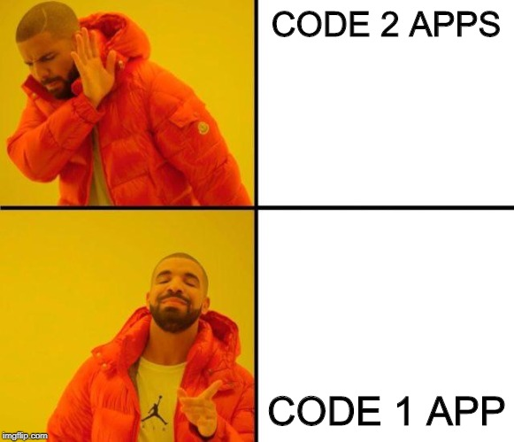
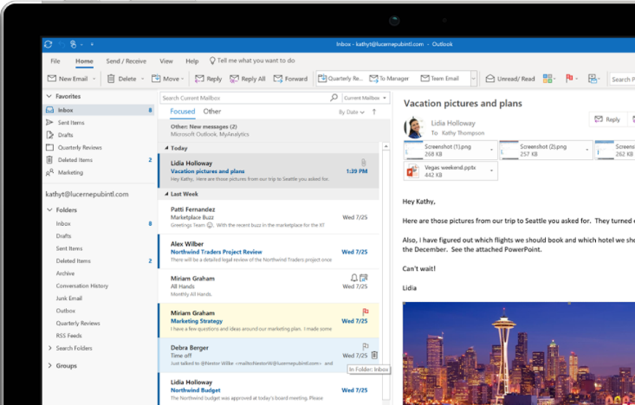

A LOT OF REPEATED WORK
Run a Robot to help you do them all

Slide 5
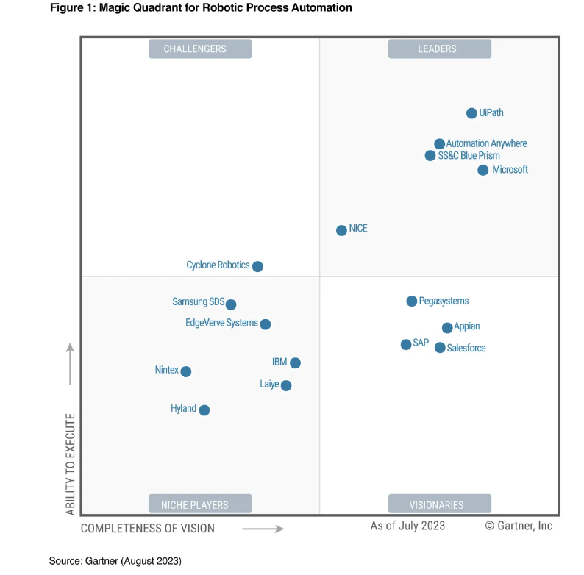

Slide 6
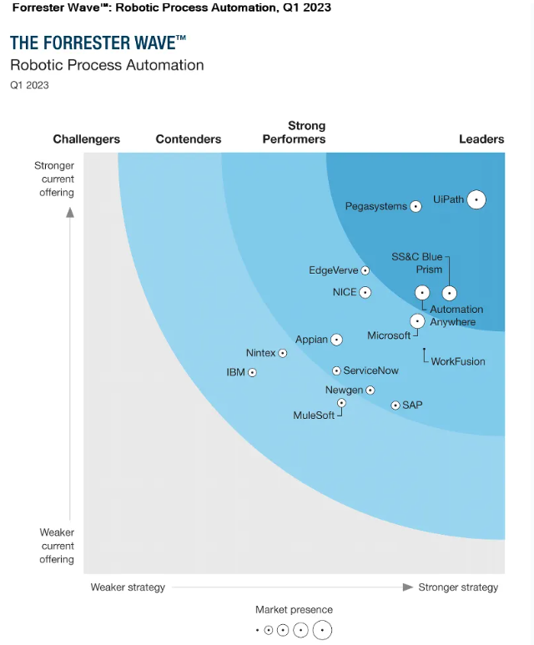
UiPath
Number 1 Robotic Process Automation Company in the world.
200,000-strong developer community,
7 Million+ robots at work
Working with 2,500 global enterprises.

Slide 7
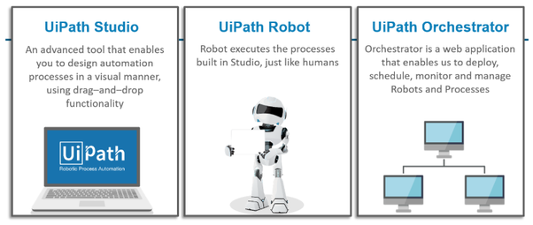

Slide 8

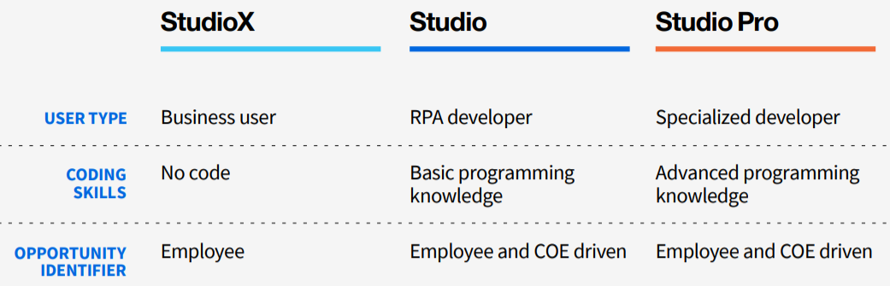
No CODE? Wouldn’t StudioX be easier?
No CODE→ while easier for business users, StudioX has less ways to handle exceptions and customized codes. More complex workflows are still better sutied for Studio.

Slide 9
Types of Robots
In RPA, robots are categorized on the basis of manual intervention required.
Attended
Unattended
Robots that collaborate with a human worker.
Stand-alone robots that perform workflows.
Notes:
In RPA, robots are of two types, Attended and Unattended Robot. The classification of robots depends on whether they require manual intervention or not.
Attended robots work with human workers on business activities to speed up the repetitive front-office tasks. Attended robots reside on the workstation of the human worker and are perfect collaborators in service desk, helpdesk, and call center activities.
These robots work in the background and ensure high productivity and low handling times, while the human workers can continue to carry out their tasks unhindered. Attended robots need manual intervention, and hence, they are not fully automated. Manual intervention means when human intelligence is required for further execution or completing the task.
Unattended robots can operate without human intervention on any variety of back-office activities. Unattended robots can run in both physical and virtual environments. These robots can also be scheduled to start and stop at any time as per the business requirements. The unattended robots are maintained and guided remotely by the server. These robots are designed to work end to end without any interventions. They are independent,

Slide 10
Check your knowledge
Notes:
Now it’s your turn to test what you have learned so far. I will challenge you with 5 questions. You need to answer at least 4 to successfully complete the quiz. Each question will have multiple answers. Its possible that more than one answer may be correct. All the best

Slide 11

What is the full-form of RPA ?
Robotic Progress Automation
b) Robotic Process Automation
c) Robots Process Automation
d) Robotic Planning Automation
Notes:
What is the full-form of RPA ?
Robotic Progress Automation
Robotic Process Automation
Robots Process Automation
Robotic Planning Automation
The correct answer to this question is option b

Slide 12
What are the benefits of RPA?
a) Increased execution speed
b) Easier scaling
c) Improved compliance and governance
d) Reduced cost of process automation
e) All of the above
Notes:
What are the benefits of RPA?
Increased execution speed
Easier scaling
Improved compliance and governance
Reduced cost of process automation
All of the above
The correct answer to this question is option e

Slide 13
How many types of Robots are there in UiPath Studio?
a) Two types
b) Three types
c) Four types
d) Five types
Notes:
How many types of Robots are there in UiPath Studio?
Two types
Three types
Four types
Five types
The correct answer to this question is option A

Slide 14
Which of the following is a good candidate for RPA?
a) Invoice Processing
b) Sales Order
c) Payroll Processing
d) Database Updating
e) All of the above
Notes:
Which of the following is a good candidate for RPA?
Invoice Processing
Sales Order
Payroll Processing
Database Updating
All of the above
The correct answer to this question is option E

Slide 15
Which processes are best suited for RPA?
a) Repetitive
b) Rule-based
c) Structured
d) All of the above
Notes:
Which processes are best suited for RPA?
Repetitive
Rule-based
Structured
All of the above
The correct answer to this question is option D

Slide 16
Introduction to RPA and UiPath
What Is RPA?
Introducing UiPath Studio
Creating your first Robot – Hello World!

Slide 17
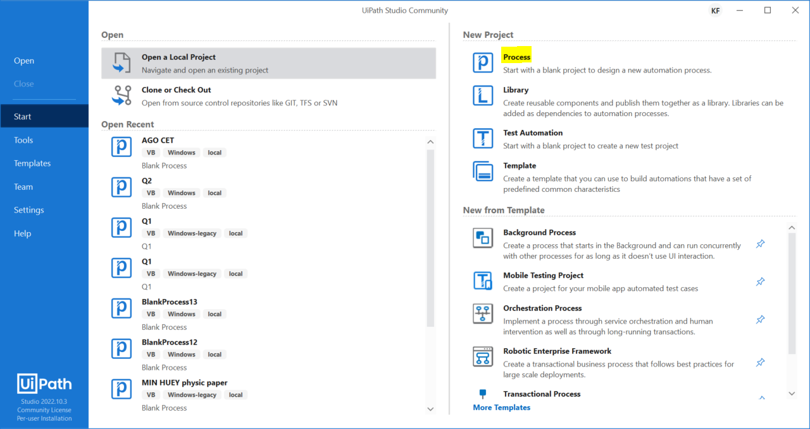
Process section is create new projects. You will use this frequently when developing your Robots.
The User Interface – Start Menu
Click here to create new project
Open a Local Project allows you to navigate to project folders to open projects
Open Recent shows list of recent opened/created projects. Typically you may access your projects from here
Notes:
New Project has two options: Process and Library
A. Process section is used to develop simple robots. You will use this frequently and also in developing your first Robot.
B. Library section helps you create reusable components and publish them together as a library. Libraries can be added as dependencies to automation processes.
New from Template has three sections:
Transactional process. These templates create a transactional process. They are used by Enterprises to create enterprise-level robots. Enterprise-level robots can perform multiple tasks like logging, error handling, etc. These templates provide basic building blocks for a developer to start creating automation. With Transactional process a builder can model a process as a flowchart.
B. Agent process improvement where you can trigger automation in response to a mouse or keyboard user event.
C. Robotic Enterprise framework where you can create a transactional business process that follows the best practices for large scale deployments.

Slide 18
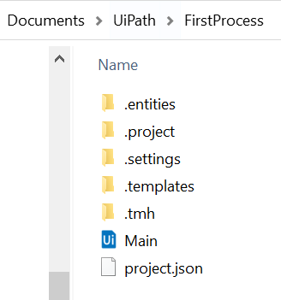
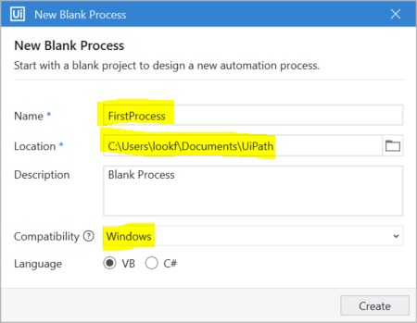
Name the project: First Process. It is important to state the process context – do not use Blank Process as process name
Location: This is the project folder. In the folder, there are the JSON project file and all the source code. It is important and typically defaulted to Documents/UiPath
Compatibility: Please ensure that you select Windows and NOT windows Legacy. Legacy support will cease soon in 2024.
Click Create
Navigate to your project folder: Try locating your project folder in Documents/UiPath. This is also where you can copy your source codes for easy transfer to other computers.
Language refers to the programming language used in the project. Please default as VB.

Slide 19
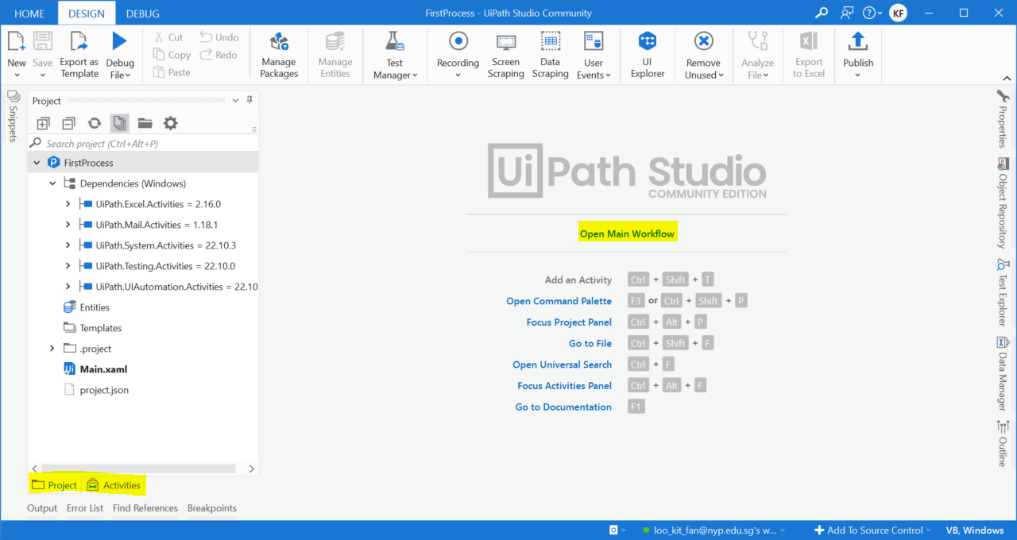

Click on Open Main Project -> the current main panel do not have any file opened.
The project files are in the Project Panel.
Main.xaml is the entry point when you run the project.
Project Panel-> Contains your project files and libraries

Slide 20
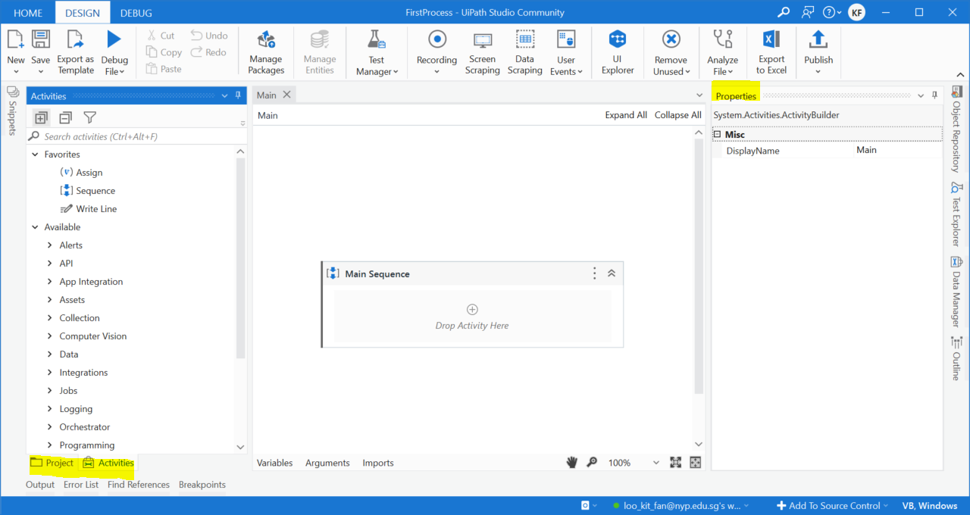
Designer Panel-> Is where you can add your robot actions
Activities Panel -> All the activities needed for your automation
Property Panel-> All the settings for selected activities
About Panels
Activities panel
-All the actions are found here!
Be sure to click on filter Icon→ Show Classic
Designer panel – Add your robot’s actions here
Properties panel
- Update your settings here
Notes:
Lets look at the three main panels in UiPath Studio:
Activities Panel contains activities corresponding to most of the actions that a user can take on a computer which are click, open, type and read. You may search in the activities, the action you want to perform on application. For example if you want to type into a text box you may search “Type” and you get that activity. If you want to read something from a file you should search “Read” and you will get multiple read options to choose from. If you want to click on the button you search “click”. Once you get the “Click” activity or other activities in this panel and you can drag drop them on designer panel to perform the actions.
Designer Panel is the largest area in the middle of the screen. This is where the automations are actually built. Once the business processes have been mapped and split into simple operations, they are converted into workflows and built in the designer panel as automation projects.
The Properties Panel displays all related properties of the activities and selected items. You can view and modify the properties as per your requirement. So for example if you drag some activity in the designer panel and click on the activity in the designer panel, the property panel will show the properties of that activity. If you have drag “Click” activity in the designer panel, in the properties panel you can see all the properties which you can change or customize.

Slide 21
The Debug/Run button allows you to test your project.
You can also manage your Project Packages here. Packages allows you to have more functionalities.
The Ribbon
Notes:
This is known as Ribbon. Ribbon has three tabs: start, design, and execute. The design tab offers the options to start new automation project using specific times available, manage activities packages of operations used in automation, filled interactions using the user interface elements like data scraping. Remove the unused variable in project, export a project to eek excel and publish a project to orchestrator or another feed.

Slide 22
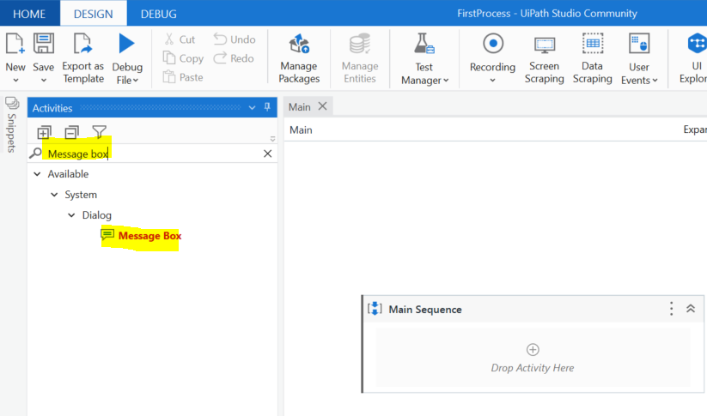
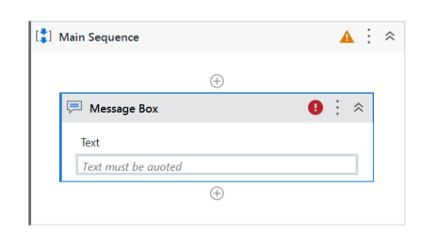
Adding an activity→ Activities are the building blocks of UiPath.
The easiest way is to search for the activity you need the robot to do.
Type Message Box in the Activity panel search box.
This is an message box activity. We can add data into the message box.
Drag the message box to the Main Sequence

Slide 23
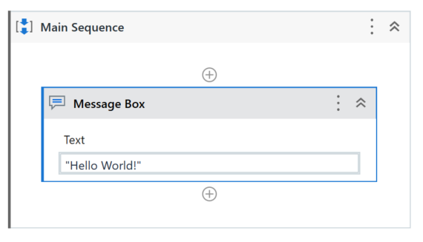
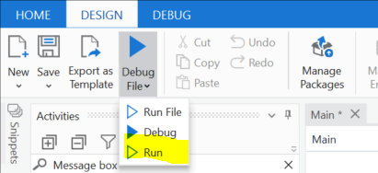
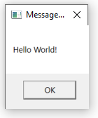
Adding an activity→ Activities are the building blocks of UiPath.
The easiest way is to search for the activity you need the robot to do.
Type "Hello World!“ in the Text value. This make a message box pop up when you run the project.
Click on the Down arrow and run to run the robot.
Congrats! You have made your first robot!

